Slide 1
Major Scales

Slide 2
Whole & Half Steps
Major (& minor) scales are made of whole steps and half steps.
A whole step is separated by 2 notes.
A half step is separated by 1 note.
The following slide will give you a visual understanding of whole steps and half steps.

Slide 3
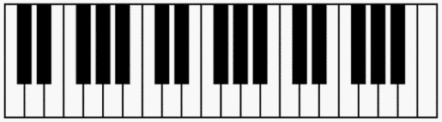
Whole Steps/Half Steps
2
1
1
1
2
1
W
W
h
h
Whole Steps (W)
Separated by TWO keys
Half Steps (h)
Separated by ONE key

Slide 4
Construction of Major Scales
A major scale is made of the following pattern:
W
W
h
W
W
W
h
The next 2 slides are examples of constructing
A mini piano with notes is provided in the top left corner to help you out.

Slide 5
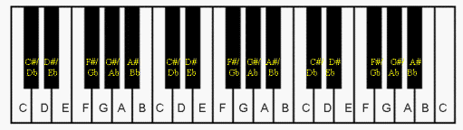
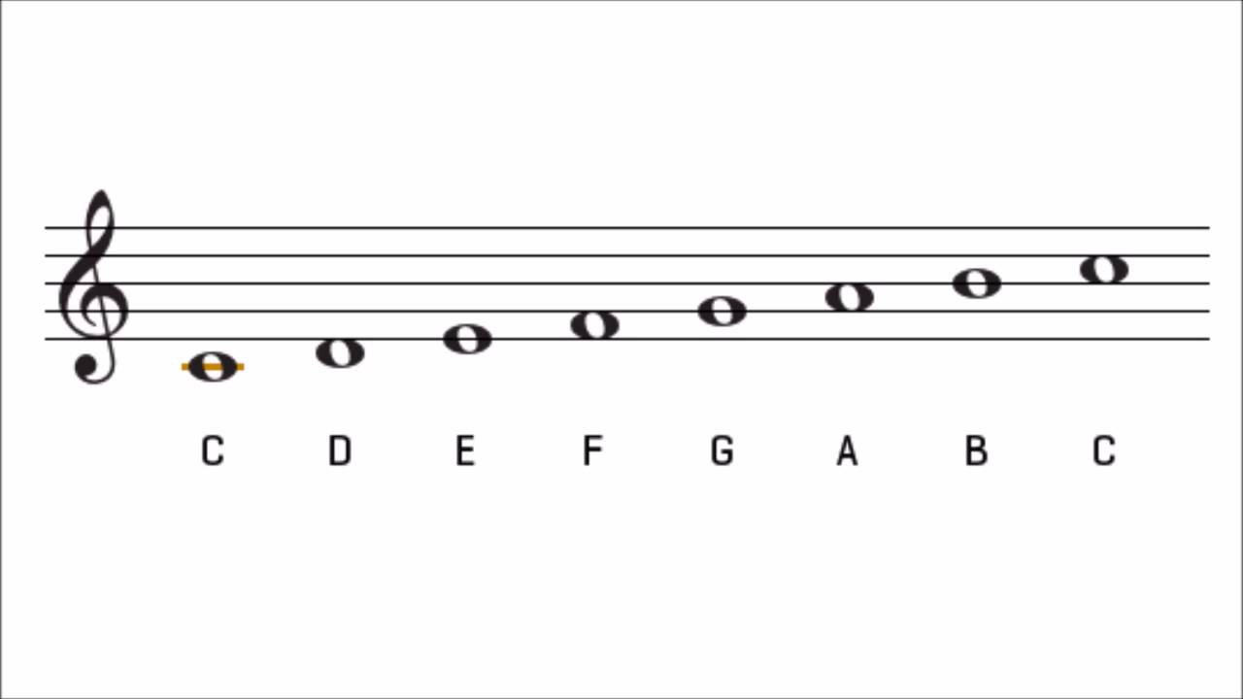
Construction
W
W
h
W
W
W
h

Slide 6
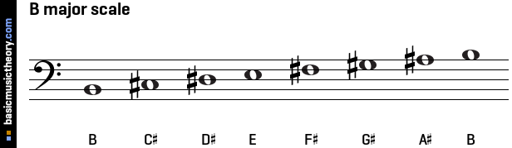
Construction
W
W
h
W
W
W
h

Slide 7
Assignment
On a WORD DOCUMENT, construct the following scales starting and ending on these notes:
  F
  A
  Bb
It does NOT have to be on staff paper. I repeat…IT DOES NOT NEED TO BE ON STAFF PAPER.
Simply write the notes of the scales in order from LEFT to RIGHT.
An EXAMPLE of what you will need to turn in can be found on the next slide. Your scales will start on different notes (see above).
Use the piano and any other online resources to help you out.
Feel free to make your assignment look interesting!!!
Please upload you assignment via itsLearning!! I figured out how to do that now.
Email any questions to Mr. Zavalla at rzavalla@ccisd.net

Slide 8
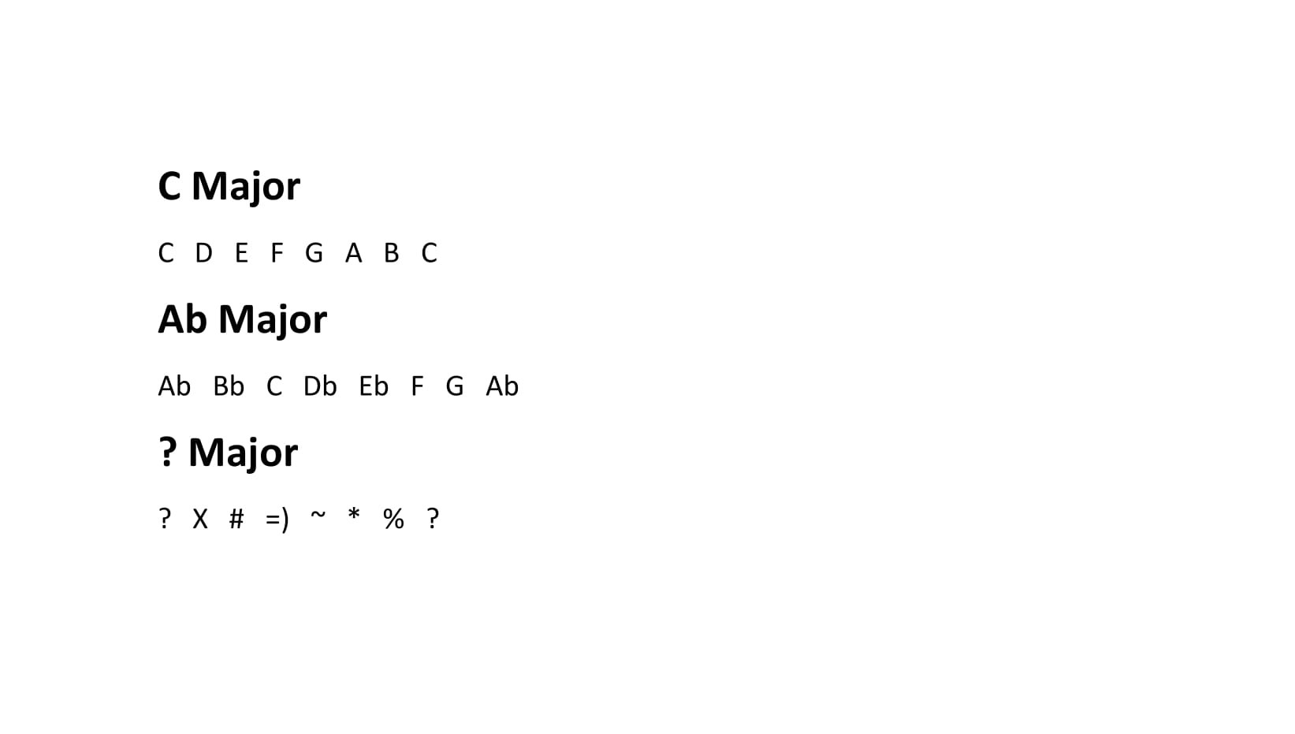
Example Assignment

